Slide 1

XYZ Front-end Project
Collaboration by: CMT

Slide 2
XYZ Cafe
Serves:
Soups
Sandwiches
Coffee and Tea
Specialty Coffee and Tea beverages
Peak hours:
10:30 AM – 1:00 PM
Front end workers:
One Cashier
One Barista

Slide 3
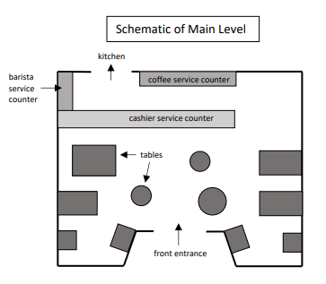
Background
Concern:
Long lines
Customers Balk
Lost Customer Loyalty
Lost Profits
Objectives:
Create three models
One cashier, one barista (replication)
Two cashiers, one barista
One cashier, one floating barista
Perform a cost-benefit analysis

Slide 4
Methods Overview
Goal: Approximate an average day’s lunch rush.
Given: Data collected from lunch rushes during weekdays from Jan 10 to Jan 28.
Difficulties: Small sample size.
Approach: Utilize Monte Carlo Simulations.

Slide 5
Arrival Analysis
Interarrival time: subtract previous party’s arrival time from each party’s time
Find the average across weekdays
Assumption: similar distribution for each weekday (small samples)
Results
Similar Interarrival averages
Exponentially distributed
Arrival rate per minute (inverse)
Mean Arrival Rates
Weekdays | Mean Interarrival Time (minutes) | Arrival Rate per Minute (λ)
Monday | 3.637 | 0.275
Tuesday | 4.074 | 0.245
Wednesday | 3.553 | 0.281
Thursday | 4.632 | 0.216
Friday | 3.463 | 0.289
Average: | 3.872 | 0.261

Slide 6
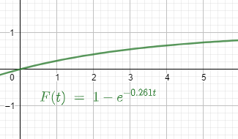

Arrival Rate for Replication Model
Decision:
Assume all days have the same arrival rate
Use the average arrival rate of$0.261$ parties per minute
Inverted cumulative distribution function:
$t=\frac{−\ln\left(1−F\left(t\right)\right)}{0.261}$, where $F(t)$is a random number between 0 and 1.
Returns time until next customer (interarrival period)

Slide 7
Party Size(1/2)
Parties bigger than four?
Theoretically, parties could arrive in bigger numbers.
Small sample and only 7 possible occurrences were recorded.
Concluded with the assumption: parties are one to four.
Finding:
There is no discernible pattern.

Slide 8
Party Size (2/2)
Decision:
Use averages for party sizes
Parties of one: 30.80%
Parties of two: 38.99%
Parties of three: 22.60%
Parties of four: 7.61%
Modeled with the CDF.
Returns Party size
Table 7: Party Size Frequency Distribution
Party Size | Relative Frequency | CDF
1 | 30.80% | 30.80%
2 | 38.99% | 69.79%
3 | 22.60% | 92.39%
4 | 7.61% | 100.00%

Slide 9
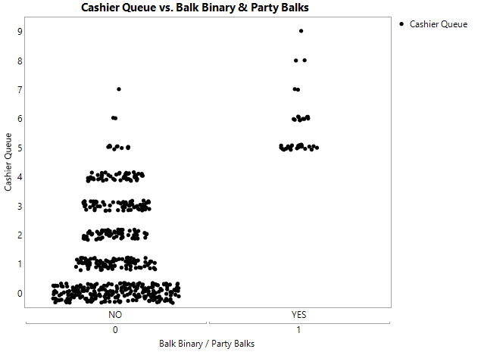

Balking Correlation
Correlation to Balking
Correlation | Party | Cashier Queue | Barista Queue | Total of Queues
r | 0.054598744 | 0.585613028 | 0.027630396 | 0.533740281
r^2 | 0.30% | 34.29% | 0.08% | 28.49%
Check if balking increases significantly in relation to Party Size, Cashier Queue, and Barista Queue
Approach:
Use Excel’s correlation function to find $r$-values for each variable
Determine $r^{2}$
Finding:
Cashier Queue is the most significant
Decision:
Assume balking is related to only cashier queue length.

Slide 10
Balking and Cashier Queue
Immediately recognize that balking occurs at 5+ cashier queue length.
Approach:
Find all occurrences of queue length greater than 4
Sort by cashier queue length
Determine frequencies for balking at each queue length.
Findings:
Illogical dip at queue length of 7
Prevalence of Balking
Queue Length | Balks | Total | Balk Percentage
5 | 22 | 32 | 68.8%
6 | 11 | 13 | 84.6%
7 | 2 | 3 | 66.7%
8 | 2 | 2 | 100.0%
9 | 1 | 1 | 100.0%

Slide 11

Balking and Cashier Queue
Findings (cont.):
Small sample size
51 parties arrived while cashier queue greater than 4
38 occurrences of balking total
Behaved as expected
Longer line
Higher balk chance
Decision:
Due to small sample size, utilize a trendline to fill in for queue length of 7.
$f(7) = 0.95$

Slide 12
Order Types
Discrete Variable, with large sample size.
Decision:
Model with CDF.
Returns Order Type per customer.
Order Type Frequency
Order Type | Count | Frequency | CDF
Coffee: | 184 | 16.17% | 16.17%
Food: | 193 | 16.96% | 33.13%
Specialty: | 364 | 31.99% | 65.11%
Food + Coffee: | 143 | 12.57% | 77.68%
Food + Specialty: | 254 | 22.32% | 100.00%

Slide 13
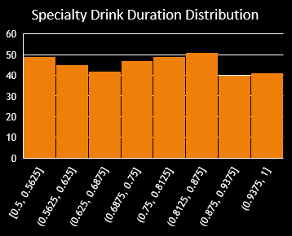
Order Duration(1/2)
Approach:
Sort the data by Order type.
Find the summary statistics.
Uniformly distributed.
Example Histogram.
Mean = (Min + Max) / 2.
Order Type Durations
Order Type | Minimum Duration (min) | Maximum Duration (min) | Average Duration
Coffee: | 0.5 | 0.99 | 0.759
Food: | 0.77 | 2.44 | 1.578
Specialty: | 0.5 | 1 | 0.747
Food + Coffee: | 0.75 | 2.49 | 1.614
Food + Specialty: | 0.75 | 2.5 | 1.646

Slide 14

Order Duration (2/2)
Decision
Determine Order duration by if the order includes food or not.
Modeled by:
Use corresponding Inverse CDF of prior determined order type.
$f\left(x\right)=MIN+x \left(MAX −MIN\right)$
Where x is a random number between 0 and 1.
Returns Order Duration per Order.
Order Durations
 | MIN (in min) | MAX (in min)
Coffee/Specialty Drink Orders: | 0.5 | 1
Orders w/ Food: | 0.75 | 2.5

Slide 15
Order Pricing
The menu was sorted into the 5 groups used in the data provided.
Averages were found to roughly estimate revenue for each order.
Order Type Prices
Order Type | Average
Food | $ 6.03
Specialty | $ 4.46
Coffee/tea | $ 2.68
Food + Specialty | $ 10.49
Food + Coffee | $ 8.71
All | $ 4.75

Slide 16
Barista Order Duration
How long until Barista finishes Specialty Drink
Approach:
Find Summary Statistics by day.
Findings:
Little variability between days.
Data appears uniformly distributed.
Decision:
Assume Barista Duration follows a uniform distribution between 0.75 and 1.5.
Modeled by inverse uniform CDF.
Returns Barista Order duration.
Table 5: Barista Duration | Minimum | Maximum | Mean
Mondays | 0.75 | 1.5 | 1.180
Tuesdays | 0.75 | 1.5 | 1.145
Wednesdays | 0.75 | 1.49 | 1.130
Thursdays | 0.76 | 1.48 | 1.122
Fridays | 0.75 | 1.5 | 1.106
Total | 0.75 | 1.5 | 1.120

Slide 17
The Model
The “Trial” Segment
The “Timestamp” Segment
The “Core”
Interarrival Block
Cashier Block
Barista Block

Slide 18
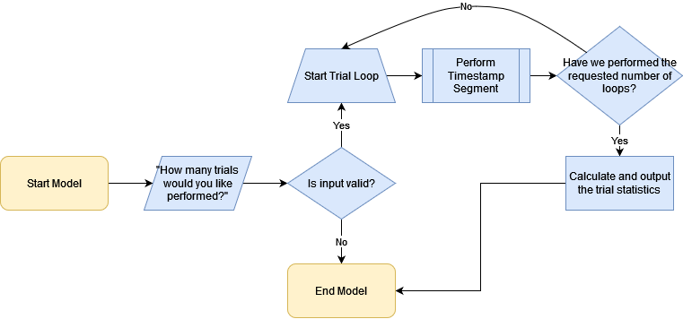
The “Trial” Segment

Slide 19
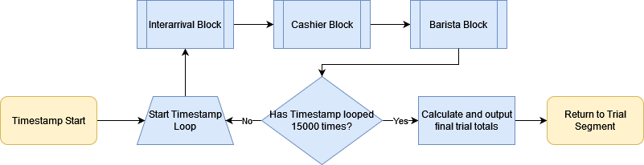
The “Timestamp” Segment

Slide 20
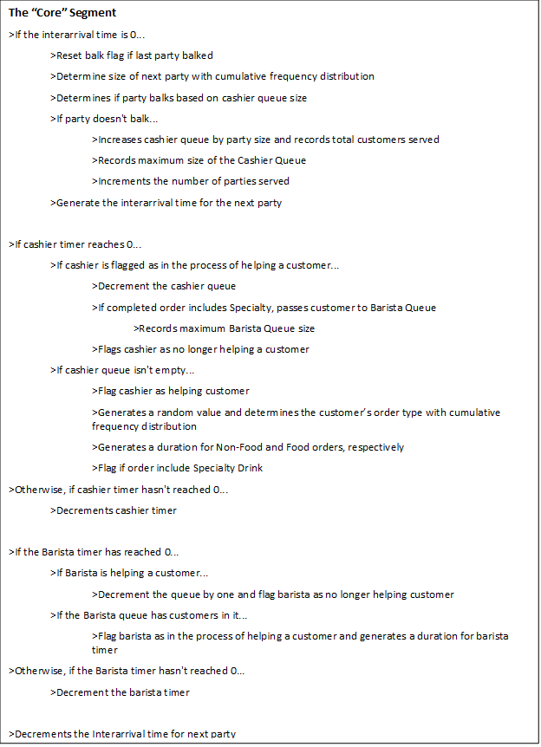
The “Core”

Slide 21
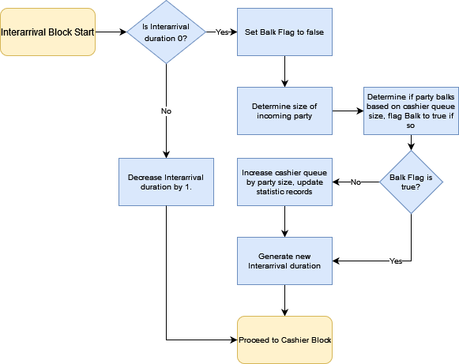
The Interarrival Block

Slide 22
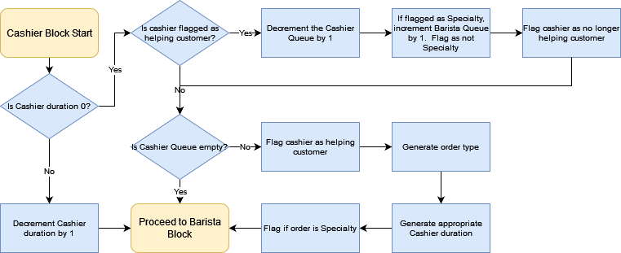
The Cashier Block

Slide 23
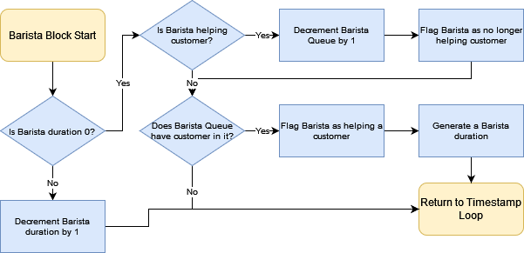
The Barista Block

Slide 24
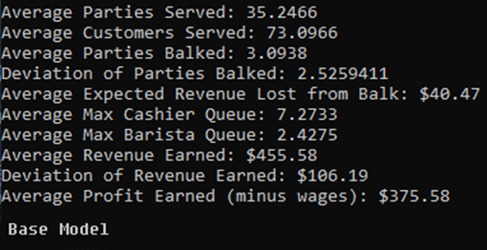
Model Validation
The average output of 10,000 trials on the model were found to be similar to the averages of the given data.
The averages of the model were all roughly within one standard deviation of the averages on the given data.
The model was concluded to be valid.
Model Validation
 | Data (Std Dev) | Base Model (10000 Trials)
Average Parties Served: | 39.4 (6.3) | 35.2466
Average Parties Balked: | 2.53 (0.52) | 3.0938
Average Max Cashier Queue: | 5.8 (1.7) | 7.2733
Average Max Barista Queue: | 1.9 (0.6) | 2.4275

Slide 25
Two-Cashier Model
Built with assumption of two cashiers working a single queue of customers, along with a barista as in the base model
Changes:
A second Cashier Block
Logic to prevent cashiers helping the same customer

Slide 26
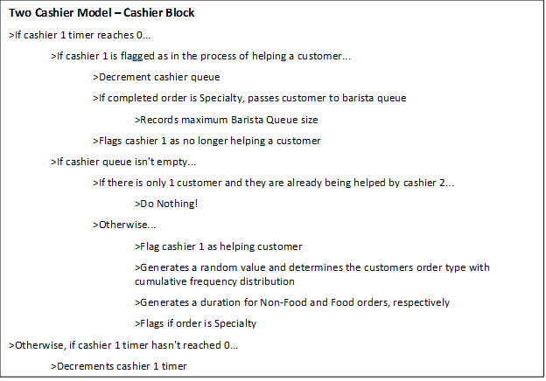
Two Cashier Model Cashier Block

Slide 27
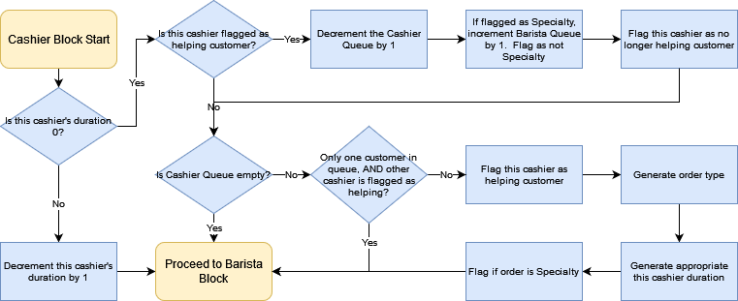
The Modified Cashier Block

Slide 28
Floating Barista Model
Built with the assumption that the Barista would prioritize customers in the Barista Queue until none remain, then assist with Cashier Queue
Changes:
Modified the Barista block to act as a hybrid of both Barista and Cashier block from base model
Will prioritize Barista Queue over Cashier Queue
Logic to prevent the barista, as cashier, from helping same customer as primary cashier

Slide 29
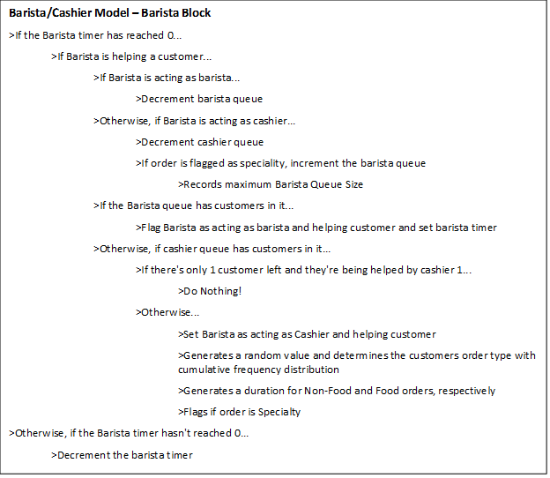
Floating Barista Model Barista Block

Slide 30
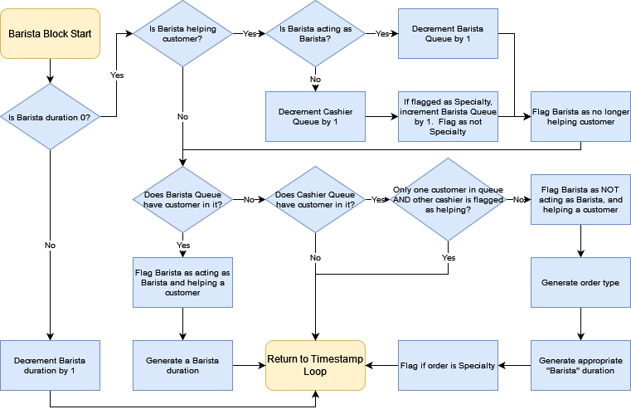
The Modified Barista Block

Slide 31
Model Outputs
Averages:
Customers Served:
Parties Balked:
Deviations:
Parties Balked
Revenue Earned
Parties Served:
Expected Revenue Lost from Balk:
Max Cashier Queue:
Max Barista Queue:
Revenue Earned:
Profit Earned:

Slide 32
Results Overview
Which model is most profitable?
Current employment?
Additional Cashier?
Floating Barista?
Directly compare model outputs.
Note for expenses:
Barista and Cashiers are paid $16/hour.
Lunch rush lasts 2.5 hours.

Slide 33
Model Comparisons
 | Base Model (10000 Trials) | Two Cashier Model (10000 Trials) | Barista Cashier Model (10000 Trials)
Average Parties Served: | 35.2722 | 37.5051 | 36.8902
Average Customers Served: | 73.1518 | 77.8143 | 76.4139
Average Parties Balked: | 3.1347 | 0.859 | 1.4051
Deviation of Parties Balked: | 2.5641654 | 1.0966932 | 1.5497754
Average Expected Revenue Lost from Balk: | $41.00 | $11.24 | $18.38
Average Max Cashier Queue: | 7.2768 | 6.563 | 6.7892
Average Max Barista Queue: | 2.4223 | 3.598 | 3.2745
Average Revenue Earned: | $455.81 | $490.37 | $479.71
Deviation of Revenue Earned: | $105.47 | $119.98 | $117.75
Average Profit Earned: | $375.81 | $370.37 | $399.71

Slide 34
Results Interpretation
Changes by the Two models:
Significantly less balking
Less variability
Higher Revenue
Two Cashiers – Less Profit
Will the barista queue bottleneck for two cashiers?

Slide 35
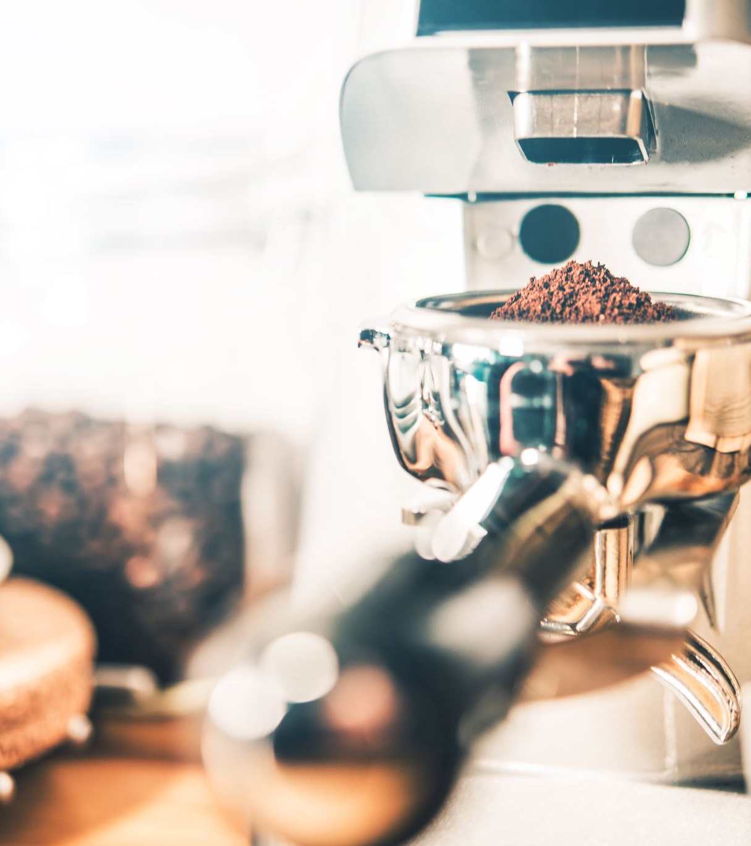
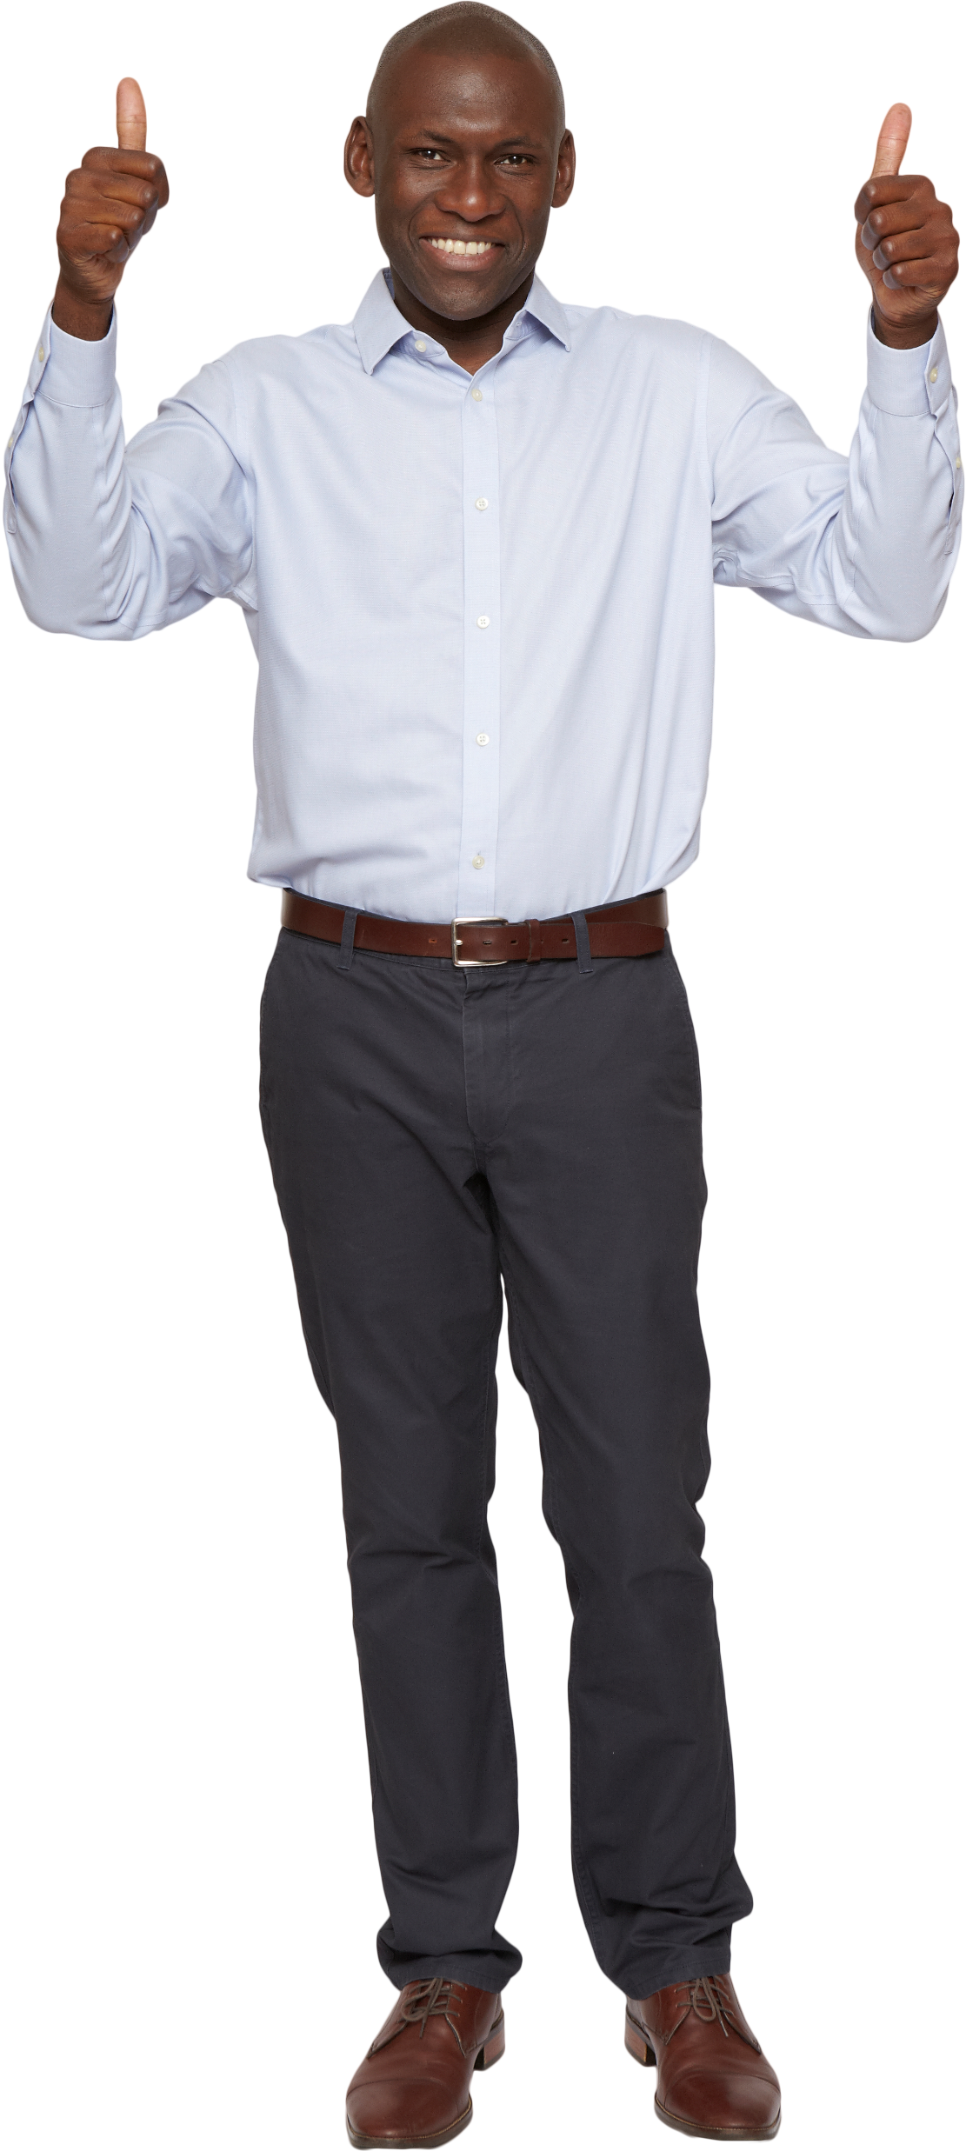

Results
Best Model:
Floating Barista Model
Increase of yearly profit by $6,500 compared to Base.
Worst Model:
Two Cashier Model
Daily profit loss of $5 compared to Base.
Best in other aspects.

Slide 36
Discussion

Slide 37

Advantages
Comprehensive simulation of employee workflow.
Directly comparable to data given.

Slide 38
Limitations
Small Sample Size
No consideration for seasons or holidays

Slide 39
Future Directions(1/2)
Larger Data set?
Can overcome limitations.
Can take into consideration business growth.
Much more effort and resources necessary.
More likely to represent the true system.
Model back-end as well?

Slide 40

Future Directions(2/2)
Different circumstances?
Hypothesize the effects of different parameters.
Ex: Legible and accessible menus reduce order time.
Barista Queue bottleneck?

Slide 41

Recommendation
Floating Barista Model
Balks decreased by 55.2%.
Decreased average maximum cashier queue by 6.7%.
4.5% increase in number parties and customers served.
Maximum barista queue length increased by 35.2%.

Slide 42

Questions?

